Slide 1





Home Irrigation Control System (HICS)
Team Status Report
November 15, 2014
Belachew
Haile-Mariam
Gautam
Adhikari
Jeremiah
O’Connor
Tung
Vo
Notes:
This presentation demonstrates the new capabilities of PowerPoint and it is best viewed in Slide Show. These slides are designed to give you great ideas for the presentations you’ll create in PowerPoint 2010!
For more sample templates, click the File tab, and then on the New tab, click Sample Templates.

Slide 2

Key Changes from SRS Gate Review

Slide 3
Key Changes
Added intelligent central control unit (2.1.1)
Clarifying web services/database (2.1.2, 3.10 )
Added more product interface mock-ups (2.3)
Added power constraint details for soil moisture sensors (3.2.3)
Updated web hosting service for clarification (3.9)
Added temperature sensor requirement (3.14)
Detailed central control unit housing constraints (4.1.3)
Added troubleshooting guide for maintenance and support (7.5)
Added more detailed risk assessments to feasibility and updated cost analysis (11.1-11.5)

Slide 4
Features and Functions
Added intelligent central control unit (2.1.1)
Missing central control unit feature overview
The control unit’s primary function is relaying input from the sensors to the web application
The control unit also receives control commands, as input, from the web application to toggle the water valves

Slide 5
Web Services/Database Management
Clarifying web services/database (2.1.2, 3.10)
Descriptions were confusing as to how data was communicated and stored.
Explained that HICS web application provides a web service
The central control unit communicates with web service to store readings from the sensors to the HICS database

Slide 6
Product Interfaces
Added more product interface mock-ups (2.3)
Region creation dialogue
User settings interface
Administrator settings interface

Slide 7
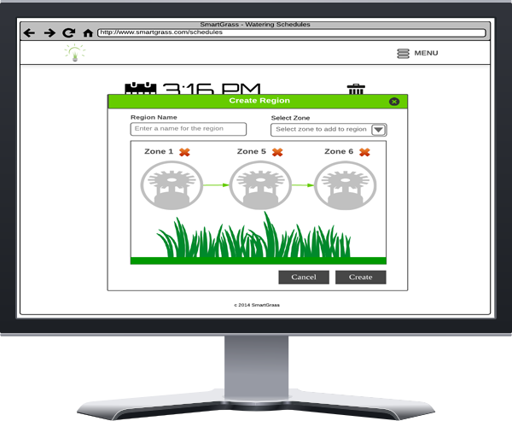
Product Interfaces
Region creation dialog (2.3.5)

Slide 8
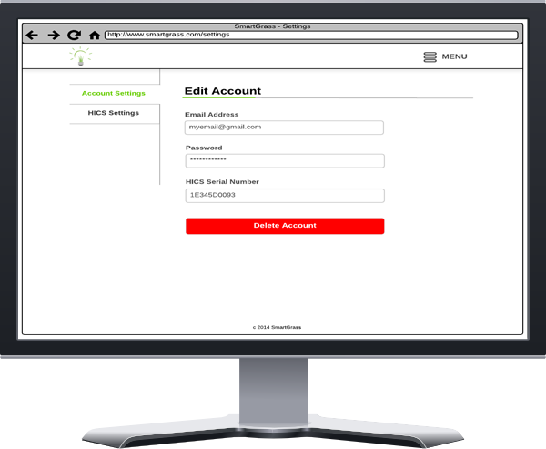
Product Interfaces
User settings interface (2.3.6)

Slide 9
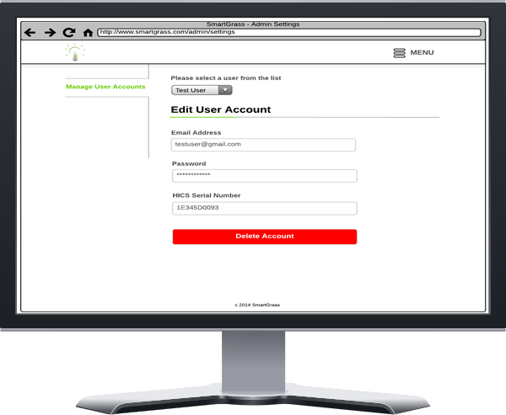
Product Interfaces
Administrator settings interface (2.3.7)

Slide 10
Customer Requirements
Added power constraint details for soil moisture sensors (3.2.3)
Power must be provided to the soil moisture sensors via the central control unit

Slide 11
Customer Requirements
Updated web hosting for clarification (3.9)
Added specifics to clarify web hosting will be provided by a 3rd party web hosting service
Updated constraints to reflect the need for a subscription for the hosting service

Slide 12
Customer Requirements
Added temperature sensor requirement (3.14)
A temperature sensor attached to the central control unit will monitor local temperature conditions
To avoid unnecessary watering and water freezing hazards HICS will not water if the sensor detects temperatures around freezing (32° F)

Slide 13
Product Packaging
Detailed central control unit housing constraints (4.1.3)
Added clarifications for mounting the central control unit housing
Updated constraints to specify to mount the housing inside in a location sheltered from external weather conditions
The central control unit housing, therefore, does not need to be waterproof

Slide 14
Maintenance and Support
Added troubleshooting guide for maintenance and support (7.5)
Troubleshooting guide is crucial for maintaining the product after the sale
A troubleshooting guide will detail possible problems the user might encounter with HICS and how to resolve those issues
Guide will be provided in English only

Slide 15
Feasibility
Updated cost and risk analysis (11.1 – 11.5)
Part | Cost
Raspberry Pi microcontroller | $70.00
Soil moisture sensor (3) | $20.00
Water valve (3) | $60.00
Web hosting subscription (6 months) | $60.00
Rain sensor | $15.00
Plumbing materials | $25.00
Microcontroller case | $20.00
Sprinkler (3) | $10.00
Waterproof sensor case (3) | $45.00
Miscellaneous parts (wires, adapters, etc) | $50.00
Temperature sensor | $12.00
Total | $387.00
Updated scope & tech analysis to detail lack of experience risks
Updated technical analysis to specify avoidance plan for overly optimistic schedule

Slide 16
System Architecture Planning

Slide 17
Architecture Design
What have we started?
Started work on our blueprint for how HICS will be built
Group meetings and Google Hangouts discussions to start defining our top-level components and subsystems
Researching hardware and software products to design the specifics of how data flows throughout HICS

Slide 18
Architecture Design
What is next?
More research and planning to define the top-level breakdown of HICS
Review previous class architecture design documents
Define our rules for design
Once we’ve established our initial baseline:
Meet with sponsor to evaluate if our architecture meets The Four I’s criteria
Divide labor and begin working on the design document

Slide 19
Any Questions?
?

